Slide 1

©1992-2010 by Pearson Education, Inc. All Rights Reserved.

Slide 2

Data structures—collections of related data items.
Arrays—data structures consisting of related data items of the same type.
  Make it convenient to process related groups of values.
  Remain the same length once they are created.
Enhanced for statement—provides easier access to the data in an array than does the counter-controlled for statement presented in Section 4.3.
Use variable-length argument lists to create methods that can be called with varying numbers of arguments.
Demonstrate how to process command-line arguments in method main.
static methods of class Arrays from the java.util package.
©1992-2010 by Pearson Education, Inc. All Rights Reserved.

Slide 3

After discussing arrays, we introduce one of Java’s prebuilt data structures from the Java API’s collection classes.
  Greater capabilities than traditional arrays.
  Reusable, reliable, powerful and efficient and have been designed and tested to ensure quality and performance.
  Focus on the ArrayList collection.
ArrayLists are similar to arrays but provide additional functionality, such as dynamic resizing—they automatically increase their size at execution time to accommodate additional elements.
.
©1992-2010 by Pearson Education, Inc. All Rights Reserved.

Slide 4
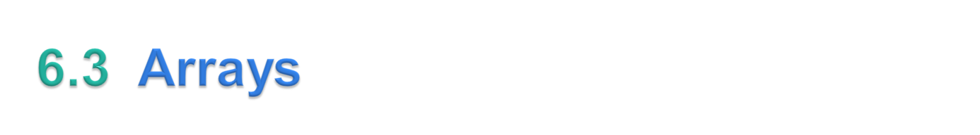
An array is a group of variables (called elements or components) containing values that all have the same type.
Arrays are objects, so they’re considered reference types.
Elements can be either primitive types or reference types.
To refer to a particular element in an array, we specify the name of the reference to the array and the position number of the element in the array.
  The position number of the element is called the element’s index or subscript.
©1992-2010 by Pearson Education, Inc. All Rights Reserved.

Slide 5
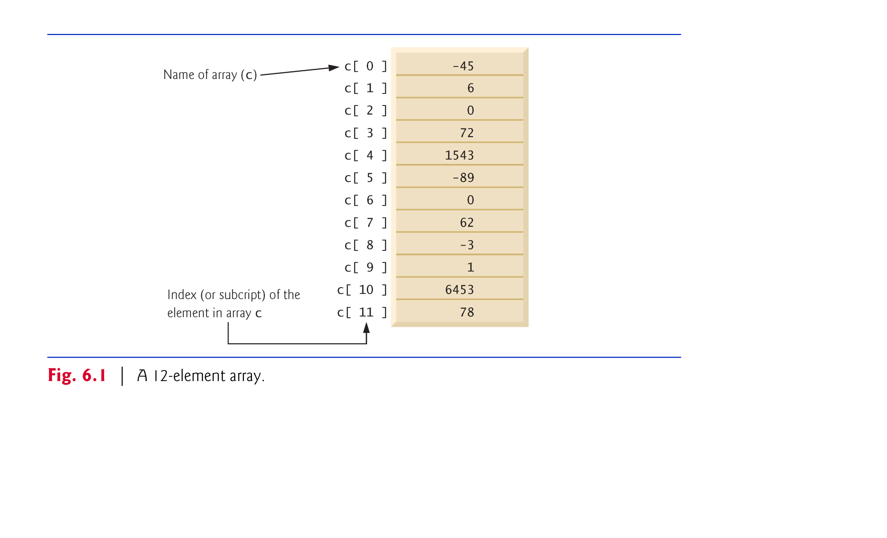
©1992-2010 by Pearson Education, Inc. All Rights Reserved.

Slide 6
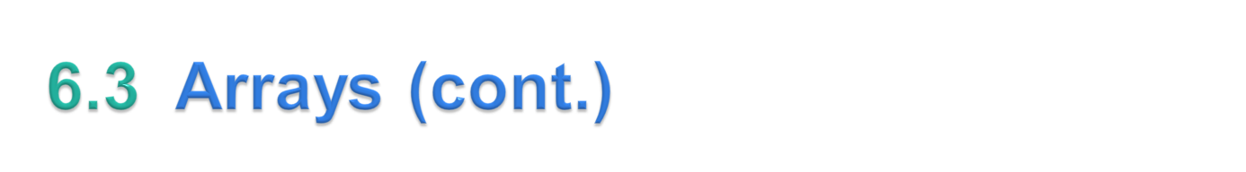
A program refers to an array’s elements with an array-access expression
  The name of the array followed by the index of the particular element in square brackets ([]).
The first element in every array has index zero and is sometimes called the zeroth element.
The highest index in an array is one less than the number of elements.
Array names follow the same conventions as other variable names.
An index must be a nonnegative integer.
A program can use an expression as an index.
Array-access expressions can be used on the left side of an assignment to place a new value into an array element.
©1992-2010 by Pearson Education, Inc. All Rights Reserved.

Slide 7
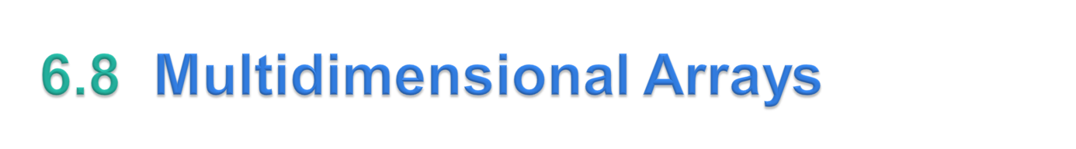
Multidimensional arrays with two dimensions often represent tables of values consisting of information arranged in rows and columns.
  To identify a particular table element, we must specify two indices—the first identifies the element’s row and the second its column.
Arrays that require two indices to identify an element are called two-dimensional arrays.
Multidimensional arrays can have more than two dimensions.
  Java does not support multidimensional arrays directly, but it does allow you to specify one-dimensional arrays whose elements are one-dimensional arrays, thus achieving the same effect.
©1992-2010 by Pearson Education, Inc. All Rights Reserved.

Slide 8
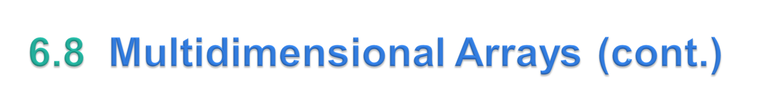
Figure 6.11 shows a two-dimensional array named a that contains three rows and four columns (i.e., a three-by-four array).
In general, an array with m rows and n columns is called an m-by-n array.
©1992-2010 by Pearson Education, Inc. All Rights Reserved.

Slide 9
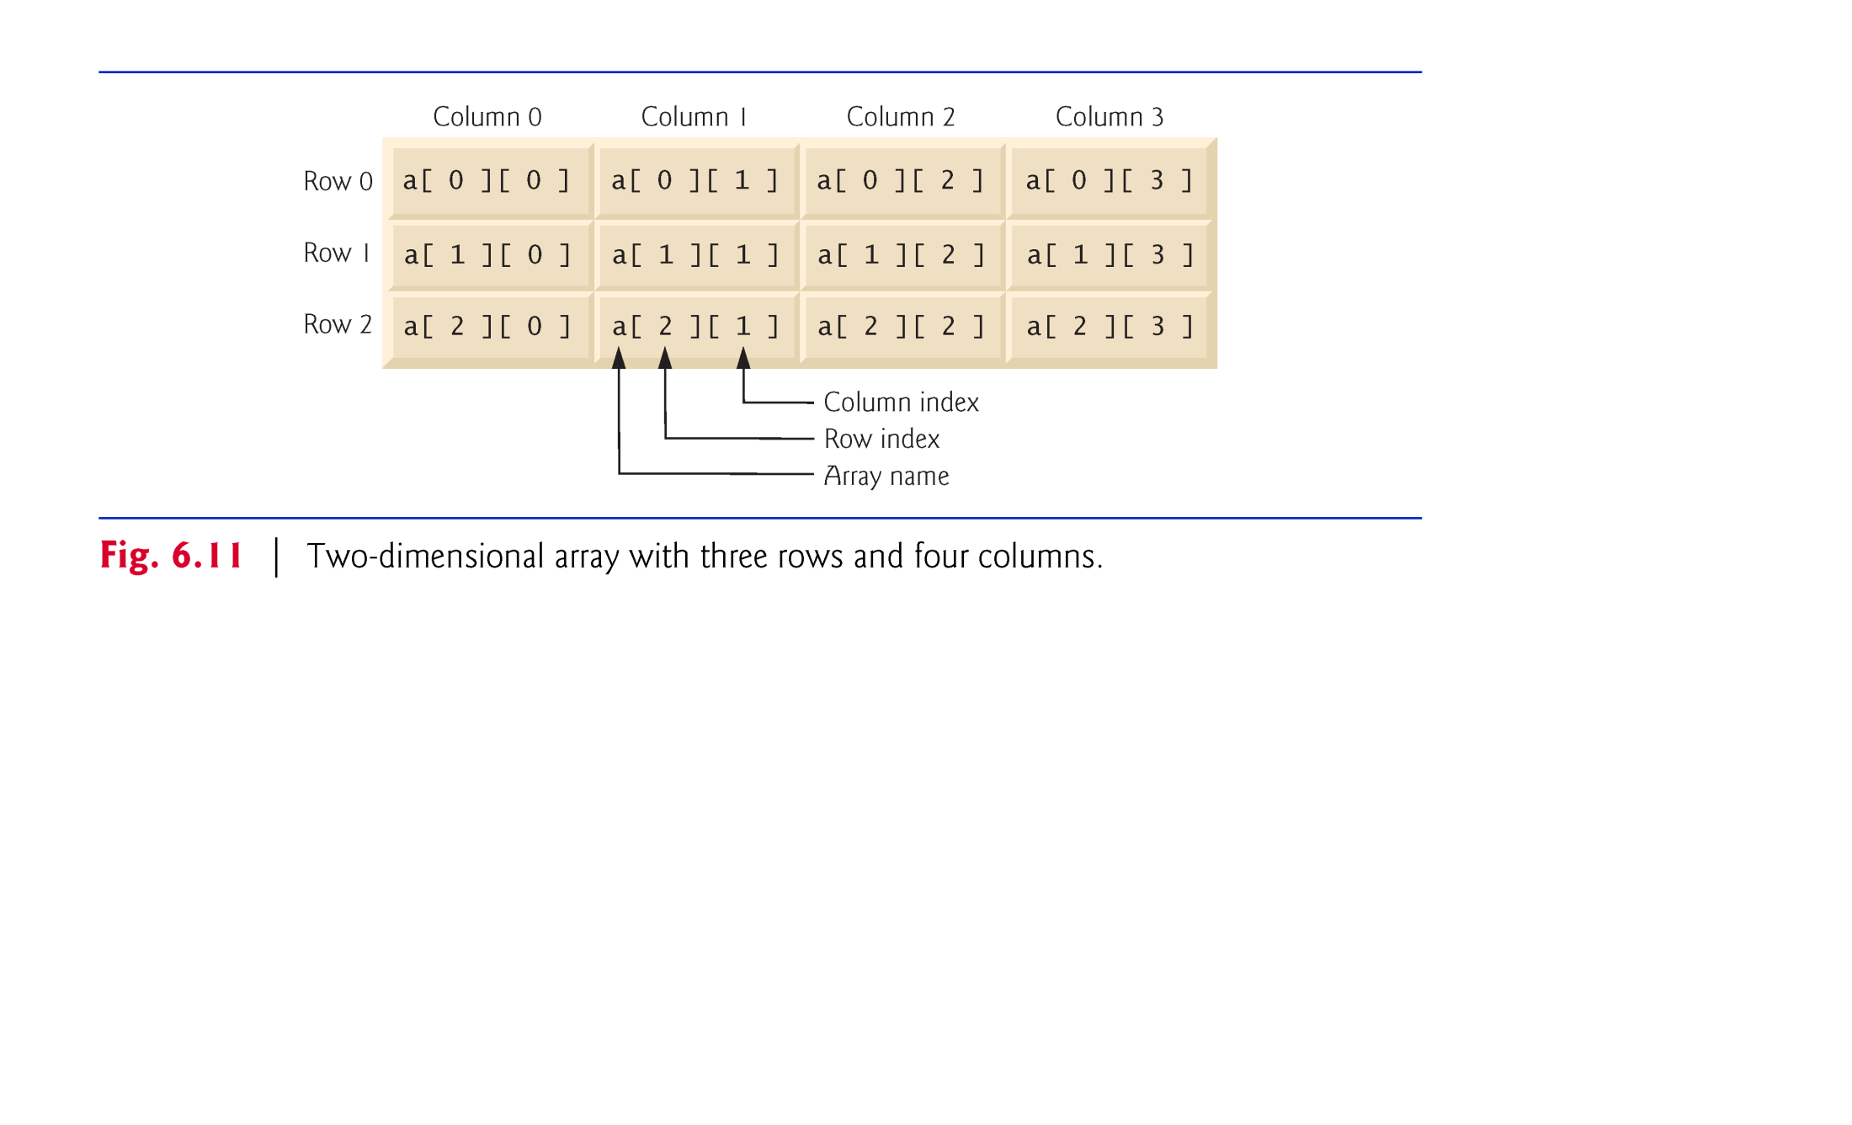
©1992-2010 by Pearson Education, Inc. All Rights Reserved.

Slide 10
Multidimensional arrays can be initialized with array initializers in declarations.
A two-dimensional array b with two rows and two columns could be declared and initialized with nested array initializers as follows:
    int[][] b = { { 1, 2 }, { 3, 4 } };
The initial values are grouped by row in braces.
The compiler counts the number of nested array initializers to determine the number of rows in array b.
The compiler counts the initializer values in the nested array initializer for a row to determine the number of columns in that row.
Rows can have different lengths.
Multidimensional arrays are maintained as arrays of one-dimensional arrays.
©1992-2010 by Pearson Education, Inc. All Rights Reserved.

Slide 11
A multidimensional array with the same number of columns in every row can be created with an array-creation expression, as in:
    int[][] b = new int[ 3 ][ 4 ];
Programs can also use variables to specify array dimensions, because new creates arrays at execution time—not at compile time.
As with one-dimensional arrays, the elements of a multidimensional array are initialized when the array object is created.
A multidimensional array in which each row has a different number of columns can be created as follows:
    int[][] b = new int[ 2 ][ ]; // create 2 rows
    b[ 0 ] = new int[ 5 ]; // create 5 columns for row 0
    b[ 1 ] = new int[ 3 ]; // create 3 columns for row 1
©1992-2010 by Pearson Education, Inc. All Rights Reserved.

Slide 12
Figure 6.12 demonstrates initializing two-dimensional arrays with array initializers and using nested for loops to traverse the arrays (i.e., manipulate every element of each array).
©1992-2010 by Pearson Education, Inc. All Rights Reserved.

Slide 13
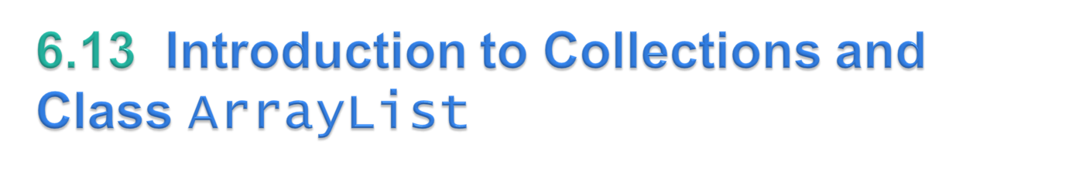
Collections provide efficient methods that organize, store and retrieve your data without requiring knowledge of how the data is being stored.
The collection class ArrayList<T> (from package java.util) can dynamically change its size to accommodate more elements.
The T is a placeholder—when declaring a new ArrayList, replace it with the type of elements that you want the ArrayList to hold.
This is similar to specifying the type when declaring an array, except that only nonprimitive types can be used with these collection classes.
Classes with this kind of placeholder that can be used with any type are called generic classes.
Figure 6.17 shows some common methods of class ArrayList<T>.
Lines 20–21 display the items in the ArrayList.
©1992-2010 by Pearson Education, Inc. All Rights Reserved.

Slide 14
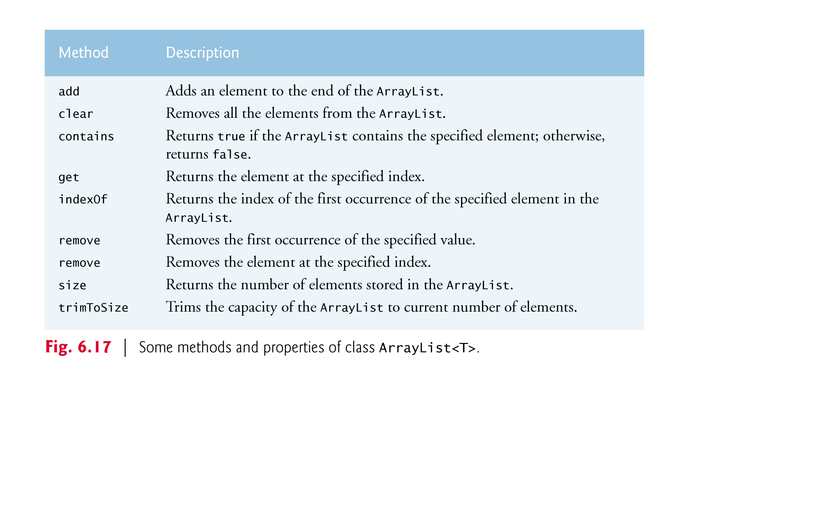
©1992-2010 by Pearson Education, Inc. All Rights Reserved.

Slide 15
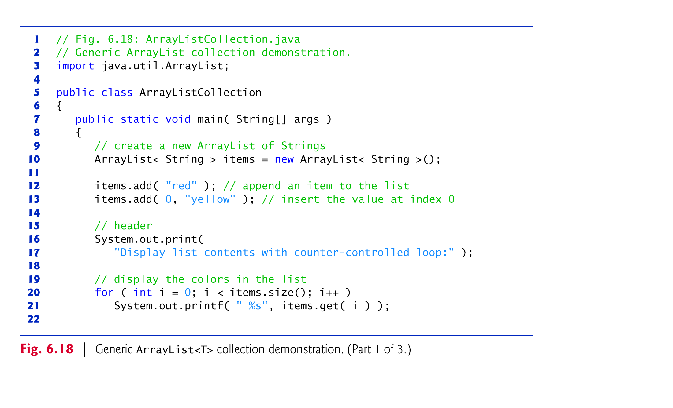
©1992-2010 by Pearson Education, Inc. All Rights Reserved.

Slide 16
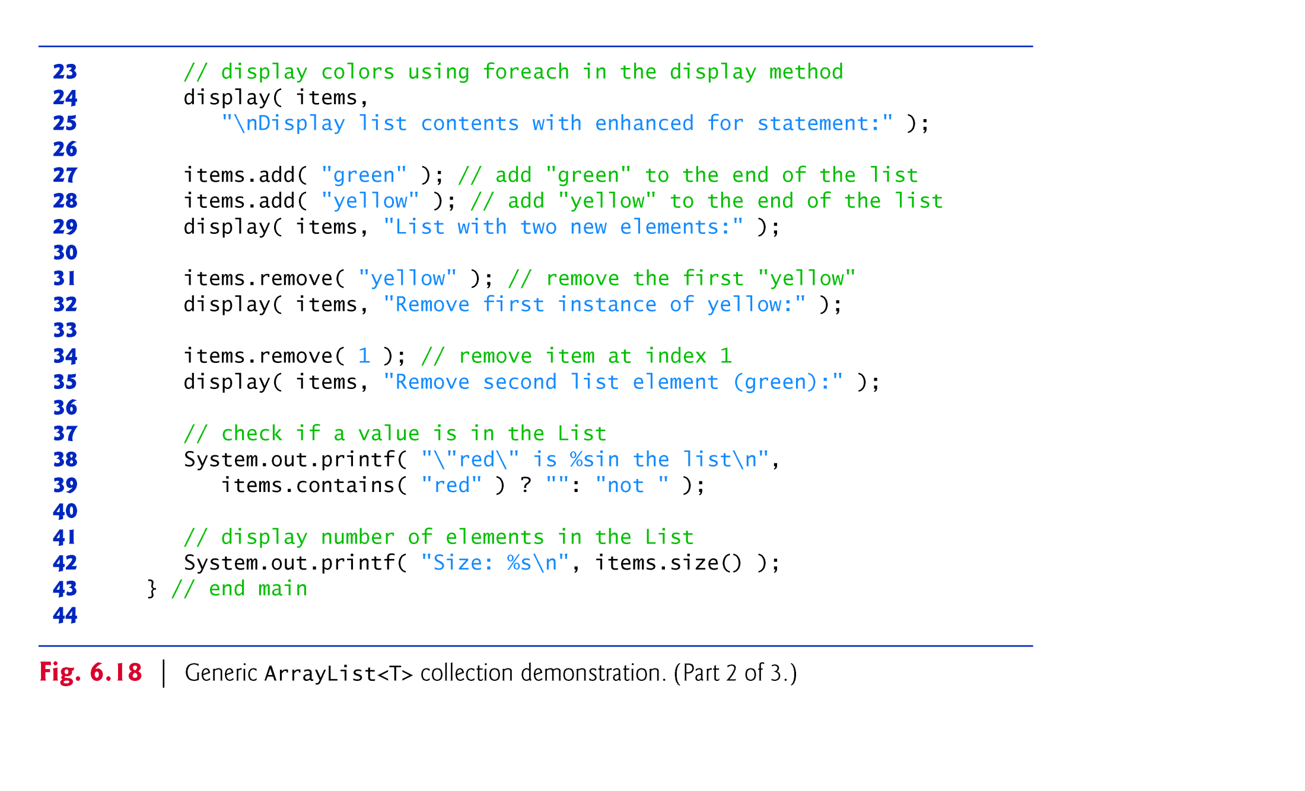
©1992-2010 by Pearson Education, Inc. All Rights Reserved.

Slide 17
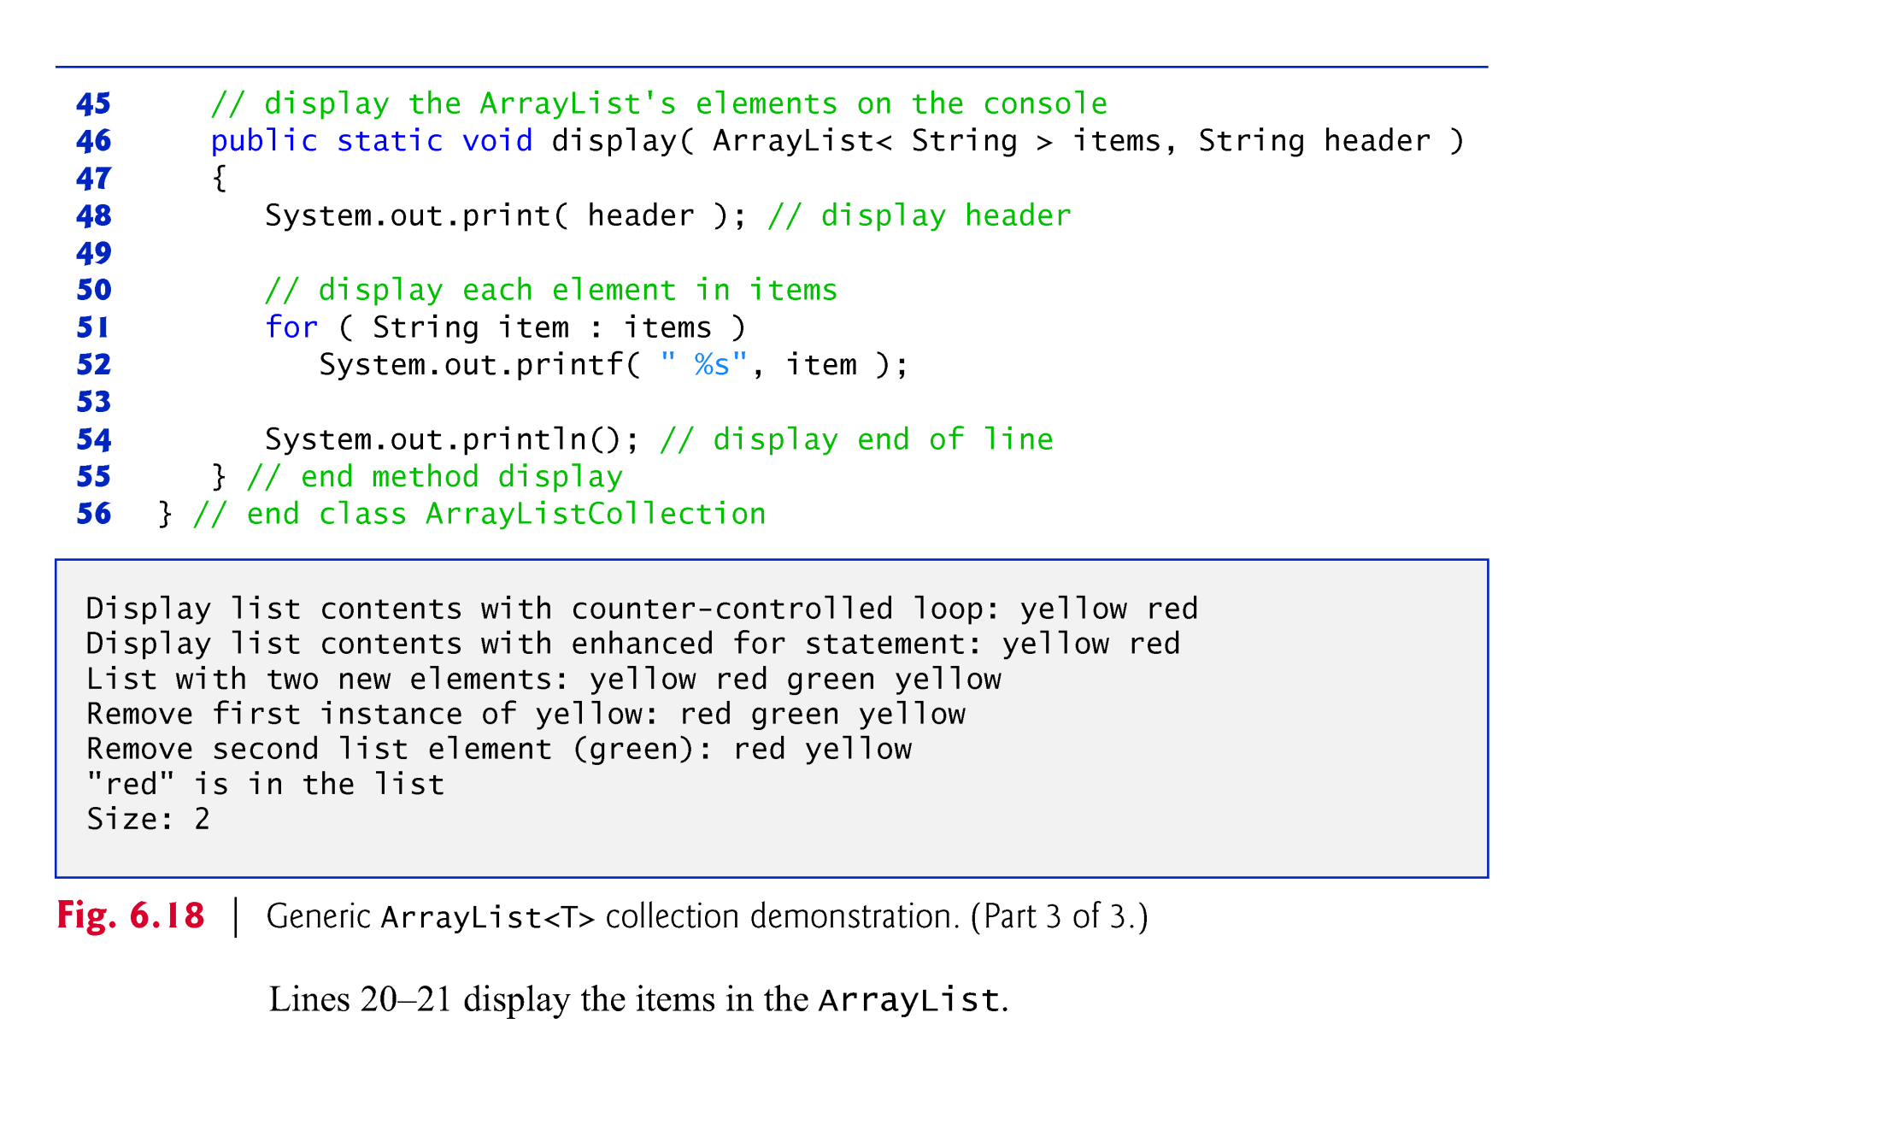
©1992-2010 by Pearson Education, Inc. All Rights Reserved.

Slide 18
指针 Pointer

Slide 19

(1) 了解指针类型的概念；
(2) 了解指针的使用与操作方法；
(3) 了解用指针访问变量、数组、字符串的方法。

Slide 20
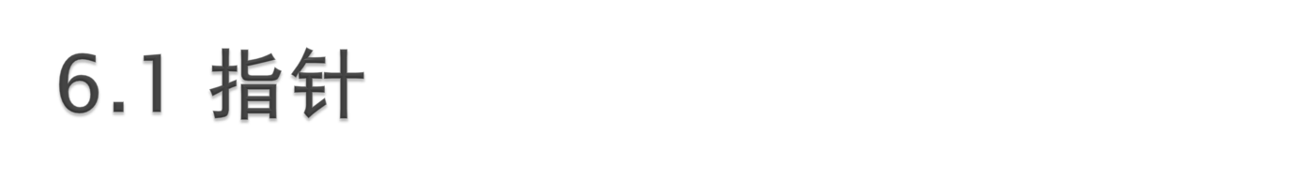
6.1.1 地址
6.1.2 指针的定义
6.1.3 指针的初始化
6.1.4 指针的使用

Slide 21
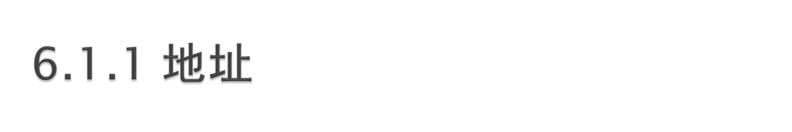
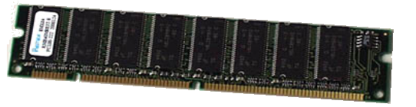
计算机的内存储器就象一个一维数组，每个数组元素就是一个存储单元。
地址是存放信息数据的内存单元的编号。
C++规定：
  变量的地址: &变量名
  数组的地址: 数组名
  函数的地址: 函数名
Notes:
程序中定义的任何变量、数组或函数等，在编译时都会在内存中分配一个确定的地址单元。
凡是存放在内存中的程序和数据都有一个地址，可以用它们占用的那片存储单元中的第一个存储单元的地址表示。

Slide 22
内存空间
int a=3,b=2;
double c[100]={8,5};
a的地址：&a
int c[10];
c[0]的地址：&c[0]
c[1]的地址：&c[1]
地 址
3
2
8
5
……
0012FF7C
0012FF78
….
0012FC58
a
b
c[0]
c[1]

Slide 23
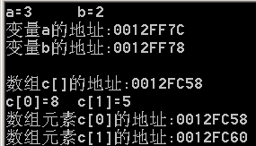
void main()
{ int a=3,b=2;
double c[100]={8,5};
cout<<"a="<<a<<'\t'<<"b="<<b<<endl;
cout<<"变量a的地址:"<<&a<<endl;
cout<<"变量b的地址:"<<&b<<endl<<endl;
cout<<"数组c[]的地址:"<<c<<endl;
cout<<"c[0]="<<c[0]<<'\t' <<"c[1]="<<c[1]<<endl;
cout<<"数组元素c[0]的地址:"<<&c[0]<<endl;
cout<<"数组元素c[1]的地址:"<<&c[1]<<endl;
}
Notes:
32位机一个字长4个字节，double 8个字节是2个存储单元

Slide 24
指 针
内存空间
地 址
3
2
int a=3,b=2;
int * ptr = &a;
ptr指向整型变量a的指针
指针变量存放的是地址,另外一个变量的地址,用于间接访问变量。
0012FF7C
0012FF78
….
a
b
ptr ;
0012FF10
0013FF7C
ptr
Notes:
一般变量里存放的是一个数值，指针变量存放的是一个地址，另外一个变量的地址,用于间接访问变量。
指向整型变量的指针
变量的地址又称为变量的指针，可由指针类型的变量存放。

Slide 25

数据类型 *指针变量名；
  int * ptr;
  float *array;
  char *s1, *s2;
Notes:
说明：
数据类型是指针所指向变量的类型；
*是一个说明符，它不是指针变量名的一部分，而是表示这里说明的是一个指针；
指针变量名是指针变量的名字

Slide 26

指针初始化的一般格式：
数据类型 *指针变量名 ＝ 初始地址值；
或 数据类型 *指针变量名；
指针变量名 = 数据对象地址；
例： int x=7;
int *ptr=&x; //指向单个变量
或： int x,*ptr;
ptr =&x;
ptr
x
&x
7
Notes:
指针在定义后必须初始化才能使用；否则，结果不确定。
其中数据对象地址可以是变量、数组、函数、结构等的地址。如：

Slide 27
1000
1001
1002
1003
1004
1005
sp
ap
2000
‘s’
‘t’
    //指向字符串
    char *sp; sp=“string”;
    //指向数组
    int a[5],*ap; ap=a;
    //指向函数
    int max(),(*fp)(); fp=max;
编程中常用的初始化方法：
    int *ptr=NULL; //空指针
‘r’
‘i’
‘n’
‘g’
‘\0’
……
1000
2000
a[0]
a[1]
a[2]

Slide 28

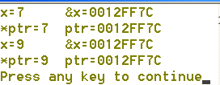
通过指针间接使用变量
通过变量名直接使用变量
int main()
{ int x = 7;
int *ptr;
ptr = &x;
cout<<"x="<<x<<'\t'<<"&x="<<&x<<endl;
cout<<"*ptr="<<*ptr<<'\t'<<"ptr="<<ptr<<endl;
*ptr= 9;
cout<<"x="<<x<<'\t'<<"&x="<<&x<<endl;
cout<<"*ptr="<<*ptr<<'\t'<<"ptr="<<ptr<<endl;
return 0;
}
ptr
x
0x0012FF7c
0x0012FF7c
7

Slide 29
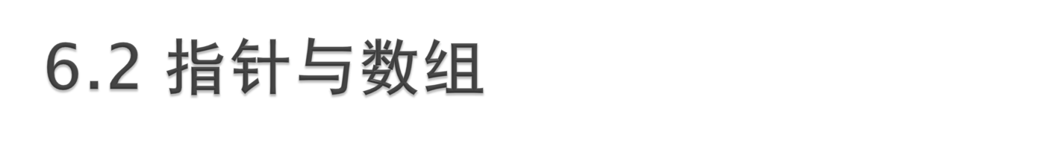
6.2.1 指针与一维数组
6.2.2 指针与字符串

Slide 30

计算机中处理数组时，实际上是将a[i]转换成
*（a+下标表达式值）的形式。即
a[i] *（a+i）
因为数组名可以表示该数组的首地址，所以：
a[i] *（a+i） *（ptr+i）
其中，ptr是指向a的指针。
Notes:
由此可见，用指针处理数组及元素是最快捷的方式

Slide 31

//使用数组名和下标
int main()
{
int a[]={1, 2, 3, 4, 5};
for(int i=0; i<5; i++)
cout<<a[i]<<"\t";
cout<<endl;
return 0;
}
//使用指针变量的方法
int a[]={1, 2, 3, 4, 5};
int *ptr = a;
for(int i=0; i<5; i++)
{
cout<<*ptr<<"\t";
ptr++;
}
//使用数组名和指针运算
for(int i=0; i<5; i++)
cout<<*(a+i)<<"\t";
Notes:
// 例6-4-1：一般方法：使用数组名和下标
#include <iostream>
using namespace std;
int main()
{
int a[]={1, 2, 3, 4, 5};
for(int i=0; i<5; i++)
cout<<a[i]<<"\t"; // 输出数组元素的值
cout<<endl;
return 0;
}
程序2
// 例6-4-2：使用数组名和指针运算
#include <iostream>
using namespace std;
int main()
{
int a[]={1, 2, 3, 4, 5};
for(int i=0; i<5; i++)
cout<<*(a+i)<<"\t"; // 输出数组元素的值
cout<<endl;
return 0;
}
程序3
// 例6-4-3：使用指针变量的方法
#include <iostream>
using namespace std;
int main()
{
int a[]={1, 2, 3, 4, 5 };
int *ptr;
ptr = a; // 使指针ptr指向数组a
for(int i=0; i<5; i++)
{
cout<<*ptr<<"\t"; // 输出数组元素的值
ptr++; // 指针变量加1
}
cout<<endl;
return 0;
}

Slide 32

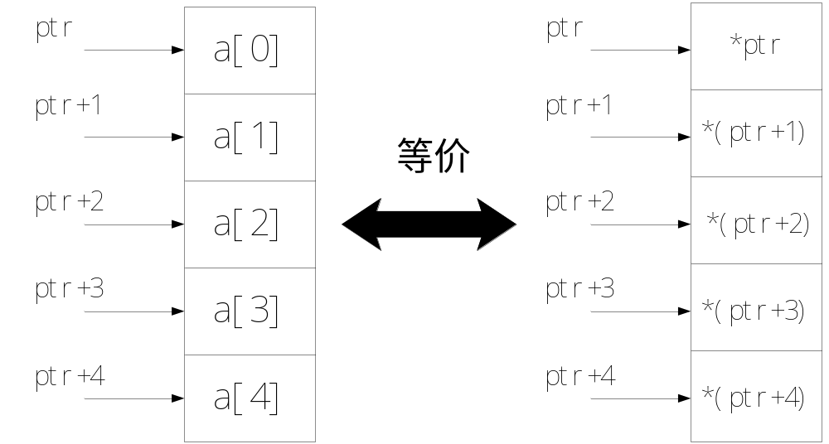

Slide 33

  设
    char *string;
    char string1[4]=“big”;
    string=string1;
  有
    string1[0] = = *string
    string1[1] = = *(string+1)
char string1[4]
string →
string+1 →
b
string1[0]
string1[1]
i
g
\0
Notes:
指针---字符数组(字符串)

Slide 34

int mystrlen(char *string)
{
char *ptr=string;
while(*ptr!= '\0')
ptr ++;
return ptr-string; }
int main()
{
char str[] = "How long am I?";
cout<<str<<" 的长度是"<<mystrlen(str)<<endl;
return 0;
}
string
ptr
str[ ]
H | o | w
I | ? | \0
char *string = str
Notes:
// 指针后移，直到指向字符串结束标志

Slide 35
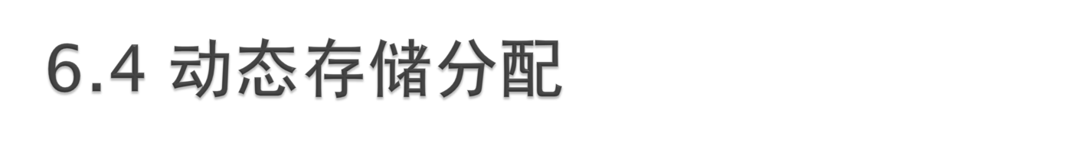
运算符new用来申请所需的内存
指针 = new 数据类型（初值）;
运算符delete用于释放先前申请到的存储块
delete 指针；
  例：
    int *p = new int (5);
    delete p;
为数组申请动态内存：
指针 = new 数据类型[数组元素个数];
释放数组占用的动态内存空间：
delete [] 指针；
  例：
    int *p = new int [size];
    delete []p;

Slide 36
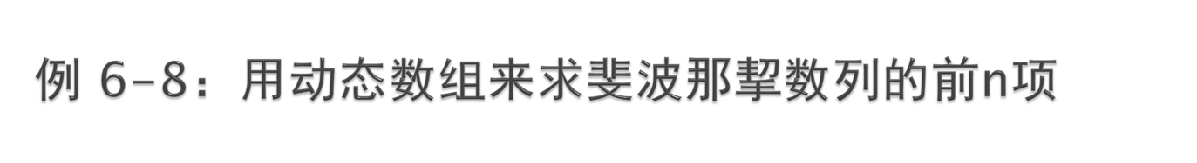
#include <iostream>
using namespace std;
int main()
{ int n;
cout<<"求斐波那挈数列的前n项，请输入n：";
cin>>n;
int *p =new int[n+1];
p[0]=0;
p[1]=1;
cout<<p[0]<<'\t'<<p[1]<<'\t';
for(int i=2; i<=n; i++)
{
p[i]=p[i-2]+p[i-1];
cout<<p[i]<<'\t';
}
delete []p; //释放数组空间
return 0;
}

Slide 37

例6-15 编写一个函数，用于去掉字符串前面的空格，并用主函数进行验证 。
  分析：
    令指针指向字符串首地址
    逐个判断字符串前面的字符是否为空格。如是，则向后移动指针继续判断，直到第一个非空格的字符出现
    将从该指针开始的字符串复制回原字符串

Slide 38
#include <iostream>
#include <cstring>
using namespace std;
char *myltrim(char * string)
{
char *ptr=string;
while(*ptr==' ') ptr++;
strcpy(string, ptr);
return string;
}
int main()
{ char str[] = " Who is Buddha?";
cout << "截取前的原始字符串是: [" <<str<<']'<<endl;
cout << "截取空格后的字符串是: [" <<myltrim(str)<<']'<<endl;
return 0;
}
运行结果：
截取前的原始字符串是: [ Who is Buddha?]
截取空格后的字符串是: [Who is Buddha?]

